Slide 1

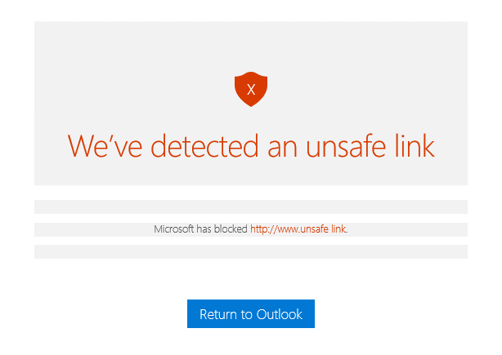
Examples of Security flaws in an application
Security testing
Web-based Payroll systems, Shopping Malls, Banking, and Stock Trade applications are not only being used by organizations but are also being sold as products today.
This means that online applications have gained the trust of customers and users regarding their vital feature named SECURITY. No doubt, that security factor is of primary value for desktop applications too
35%
A Student Management System is insecure if the Admission branch can edit the data of the ‘Exam’ branch.
23%
An ERP system is not secure if a DEO (data entry operator) can generate ‘Reports’.
A custom software possesses inadequate security if an SQL query retrieves actual passwords of its users.

Slide 2
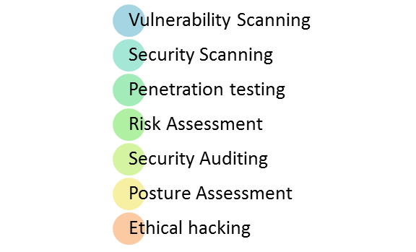
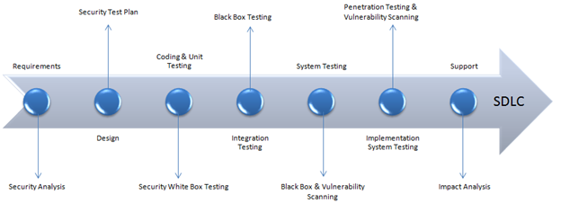
Types of Security Testing:
How to do Security Testing
For more information, visit https://www.softwaretestinghelp.com/how-to-test-application-security-web-and-desktop-application-security-testing-techniques/

Slide 3
SDLC Phases | Security Processes
Requirements | Security analysis for requirements and check abuse/misuse cases
Design | Security risks analysis for designing. Development of Test Plan including security tests
Coding and Unit Testing | Static and Dynamic Testing and Security White Box Testing
Integration Testing | Black Box Testing
System Testing | Black Box Testing and Vulnerability scanning
Implementation | Penetration Testing, Vulnerability Scanning
Support | Impact analysis of Patches

Slide 4
Security – Meaning
“Security means that authorized access is granted to protected data and unauthorized access is restricted”.
Desktop And Web Security Testing
A desktop application should be secure not only regarding its access but also with respect to the organization and storage of its data.
Similarly, web applications demand, even more, security with respect to its access, along with data protection. A web developer should make the application immune to SQL Injections, Brute Force Attacks and XSS (cross-site scripting). Similarly, if the web application facilitates remote access points then these must be secure too.
Also, keep in mind that Brute Force Attack is not only related to web applications, but the desktop software is also vulnerable to this.

Slide 5


Recommended Security Testing Tools
1- OWASP: The Open Web Application Security Project (OWASP) is a worldwide non-profit organization focused on improving the security of software. The project has multiple tools to pen test various software environments and protocols.
2- Indusafe free web site malware checker
Indusface WAS provides both manual penetration testing bundled with its own automated web application vulnerability scanner that detects and reports vulnerabilities based on OWASP top 10 and also includes a Website reputation check of links, malware, and defacement checks of the website in every scan.
3- Netsparker
Netsparker is a web application security testing solution with the capabilities of automatic crawling and scanning for all types of legacy & modern web applications such as HTML5, Web 2.0, and Single Page Applications. It makes use of Proof-Based Scanning Technology and scalable scanning agents.

Slide 6
Top 8 Security Testing Techniques
#1) Access to Application
How to Test: In order to test this, thorough testing of all roles and rights should be performed.
The tester should create several user accounts with different as well as multiple roles. He should then be able to use the application with the help of these accounts and should verify that every role has access to its own modules, screens, forms, and menus only. If the tester finds any conflict, then he should log a security issue with complete confidence.
#2) Data Protection
There are three aspects of data security. The first one is that a user can view or utilize only the data which he is supposed to use. This is also ensured by roles and rights. The second aspect of data protection is related to how that data is stored in the DB. The third and the last aspect is an extension of this second aspect. Proper security measures must be adopted when the flow of sensitive or business-critical data occurs. Whether this data floats between different modules of the same application or is transmitted to different applications, it must be encrypted to keep it safe.
For more information, visit https://www.softwaretestinghelp.com/how-to-test-application-security-web-and-desktop-application-security-testing-techniques/

Slide 7
How to Test Data Protection: The tester should query the database for ‘passwords’ of the user account, billing information of clients, other business-critical and sensitive data, should verify that all such data is saved in encrypted form in the DB.
Similarly, he must verify that the data is transmitted between different forms or screens after proper encryption only. Moreover, the tester should ensure that the encrypted data is properly decrypted at the destination. Special attention should be paid to different ‘submit’ actions.
The tester must verify that when the information is being transmitted between the client and server, it is not displayed in the address bar of a web browser in an understandable format. If any of these verifications fail, then the application definitely has a security flaw.
The tester should also check for proper use of salting (appending an extra secret value to the end input like password and thus making it stronger and more difficult to be cracked). Insecure randomness should also be tested as it is a kind of vulnerability. Another way to test data protection is to check for weak algorithm usage. For example, since HTTP is a clear text protocol, if sensitive data like user credentials are transmitted via HTTP, then it is a threat to application security. Instead of HTTP, sensitive data should be transferred via HTTPS (secured through SSL and TLS tunnels).
However, HTTPS increases the attack surface and thus it should be tested that the server configurations are proper and certificate validity is ensured.
For more information, visit https://www.softwaretestinghelp.com/how-to-test-application-security-web-and-desktop-application-security-testing-techniques/

Slide 8
#3) Brute-Force Attack
Brute Force Attack is mostly done by some software tools. The concept is that by using a valid user ID, the software attempts to guess the associated password by trying to log in again and again.
A simple example of security against such an attack is account suspension for a short period of time, as all mailing applications like Yahoo, Gmail do. If a specific number of consecutive attempts (mostly 3) fail to log in successfully, then that account is blocked for some time (30 minutes to 24 hrs).
How to test Brute-Force Attack: The tester must verify that some mechanism of account suspension is available and is working accurately. (S)He must attempt to login with invalid user IDs and Passwords alternatively to make sure that the software application blocks the account if continuous attempts are made to login with invalid credentials.
If the application is doing so, then it is secure against brute-force attack. Otherwise, this security vulnerability must be reported by the tester.
Testing for brute force can also be divided into two parts – black box testing and grey-box testing.
In Black box testing, the authentication method employed by the application is discovered and tested. Furthermore, the grey box testing is based on partial knowledge of password & account details and memory trade-off attacks. The above three security aspects should be taken into account for both web and desktop applications while the following points are related to web-based applications only.
For more information, visit https://www.softwaretestinghelp.com/how-to-test-application-security-web-and-desktop-application-security-testing-techniques/

Slide 9

#4) SQL Injection And XSS (Cross-Site Scripting)
In this approach, the malicious script is used by hackers in order to manipulate a website.
There are several ways to immune against such attempts. For all input fields on the website, field lengths should be defined small enough to restrict the input of any script
How to test SQL Injection and XSS: Tester must ensure that maximum lengths of all input fields are defined and implemented. (S)He should also ensure that the defined length of input fields does not accommodate any script input as well as tag input. Both of these can be easily tested.
#5) Service Access Points (Sealed and Secure Open)
The tester must ensure that all inter-network and intra-network access to the application is through trusted applications, machines (IPs) and users.
In order to verify that an open access point is secure enough, the tester must try to access it from different machines having both trusted and untrusted IP addresses.
Different sorts of real-time transactions should be tried in bulk to have good confidence in the application’s performance. By doing so, the capacity of access points of the application will also be observed clearly.
The tester must ensure that the application entertains all communication requests from trusted IPs and applications only while all other requests are rejected.
For more information, visit https://www.softwaretestinghelp.com/how-to-test-application-security-web-and-desktop-application-security-testing-techniques/

Slide 10
Similarly, if the application has some open access point, then the tester should ensure that it allows (if required) uploading of data by users in a secure way. In this secure way, I mean about the file size limit, file type restriction and scanning of the uploaded file for viruses or other security threats.
#6) Session Management
A web session is a sequence of HTTP requests and response transactions linked to the same user. Session management tests check how session management is handled in the web app.
You can test for session expiry after particular idle time, session termination after maximum lifetime, session termination after log out, check for session cookie scope and duration, testing if a single user can have multiple simultaneous sessions, etc.
#7) Error handling
Testing for Error handling includes:
Check for error codes: For example, test 408 request time-out, 400 bad requests, 404 not found, etc. To test this, you need to make certain requests on the page such that these error codes are returned.
The error code will be returned with a detailed message. This message should not contain any critical information that can be used for hacking purposes
Check for stack traces: It basically includes giving some exceptional input to the application such that the returned error message contains stack traces that have interesting information for hackers.
For more information, visit https://www.softwaretestinghelp.com/how-to-test-application-security-web-and-desktop-application-security-testing-techniques/

Slide 11
#8) Specific Risky Functionalities
Mainly, the two risky functionalities are payments and file uploads. These functionalities should be tested very well. For file uploads, you need to primarily test if any unwanted or malicious file upload is restricted.
For payments, you need to primarily test for injection vulnerabilities, insecure cryptographic storage, buffer overflows, password guessing, etc.
For more information, visit https://www.softwaretestinghelp.com/how-to-test-application-security-web-and-desktop-application-security-testing-techniques/
For more information, visit https://www.softwaretestinghelp.com/how-to-test-application-security-web-and-desktop-application-security-testing-techniques/ https://www.guru99.com/what-is-security-testing.html

